Slide 1
Reminders...
You’ll use this file for the entirety of this course. Save it in a place where you can easily access it over the upcoming weeks.
You can edit and save this document in Google Drive
If you download this document, keep it in a place you can find it later
The content you put into this document will be used for later lessons
It is recommended that you do not skip any capstone readings in any of the lessons
It is recommended that you start you complete update this document after every week of content and start with week 1
Requirements:
Answer all the questions in this document
When complete, download this as a PDF document for submission in the peer review assignment.
Don’t know how to download as a PDF? You can find more information about downloading this by clicking here.
Remove this slide before submitting

Slide 2
Course 3 Capstone
Data Collection

Slide 3
Finding the Middle
Mean, Median, and Mode help you compare data. Below, list the mean, median, and mode of the clicks in the provided data.
Mean: xx
Median: xx
Mode: xx

Slide 4
Finding the Middle
Mean, Median, and Mode help you compare data. Below, list the mean, median, and mode of the conversions in the provided data.
Mean: xx
Median: xx
Mode: xx

Slide 5
Standard Deviation
Determining variance in data helps you [why this is helpful]. Below, enter the standard deviation of the provided data.
Standard Deviation of Clicks: xx
Standard Deviation of Conversions: xx

Slide 6
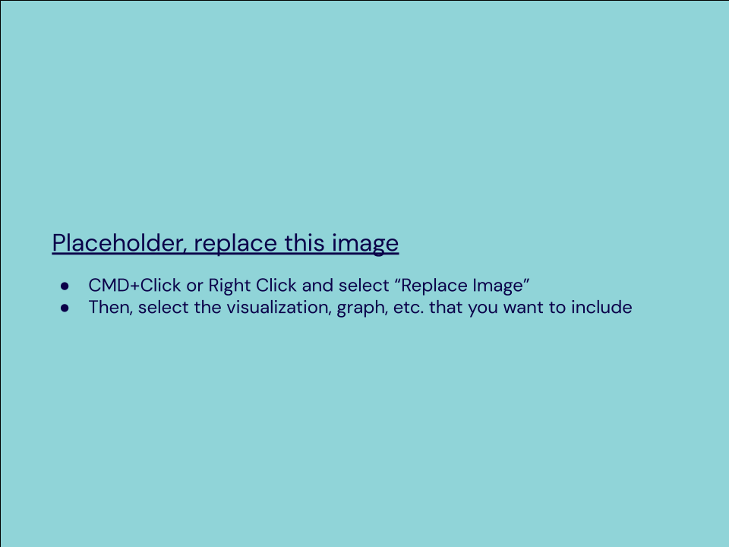
Frequency and Contingency Tables
Understanding how often something happens is important to understanding trends and patterns in your data. Create and insert a contingency table generated from your data.

Slide 7
Scatter Plot
Understanding the relationships between data is important to understanding trends and patterns. Create and insert a scatter plot generated from your data. Then, include the input the correlation coefficient as well.
Scatter Plot of your data:
Correlation coefficient: xx

Slide 8
End of Section 1

Slide 9
Sample Type
It’s important to understand the sample you’re using in your analysis. Fill in the information below about the sample you have received:
Histogram of your clicks data:
Histogram of conversions data:

Slide 10
Sample Type
It’s important to understand the sample you’re using in your analysis. Fill in the information below about the sample you have received:
Does the clicks data have a normal distribution? xx
Does the conversions data have a normal distribution? xx

Slide 11
Variable Types
Determining the types of variables your working with is an important skill. Below, list the variables from your data that are:
Quantitative:
Continuous: xx
Discrete: xx
Qualitative:
Nominal: xx
Ordinal: xx

Slide 12
End of Section 2

Slide 13
Question and Hypothesis
The question you hope to answer and your hypothesized answer are necessary to complete an analysis. Answer the following questions
What is your hypothesis based off the evaluation question? xx

Slide 14
Question and Hypothesis
The question you hope to answer and your hypothesized answer are necessary to complete an analysis. Answer the following questions
What is your independent variable? xx
What is your dependent variable? xx

Slide 15
Running a Test
With your question and hypothesis ready, run the test on the two sets of data. Fill in the information below.
Mean number of Facebook conversions: xx
Mean number of Adware conversions: xx
p-Value: xx

Slide 16
Hypothesis
After running the test, was your hypothesis proven correct?
Do your findings support a null or an alternative hypothesis? xx
What’s your conclusion about your main hypothesis? Is there a difference, and is it what your hypothesis predicted?

Slide 17
End of Section 3

Slide 18
Determining a Model
Based off what you know so far, you’ll need to determine if your data meets the assumptions for a chosen model. Including:
Which model makes the most sense to use and why?

Slide 19
Modeling
Finally, include a visualization of your complete model.

Slide 20
End of Section 4

Slide 21
Final Insights
Now, knowing what you do about the results of your test, what are the final insights that you would share with your client? What did you learn and what would you recommend? Is there anything you would do differently next time?
Enter your insights here:

